Slide 1

RCU ID proposal v1.0
27.Apr.2021 | G GROUP Industrial design department | Lynn

Slide 2

Perspective

Slide 3
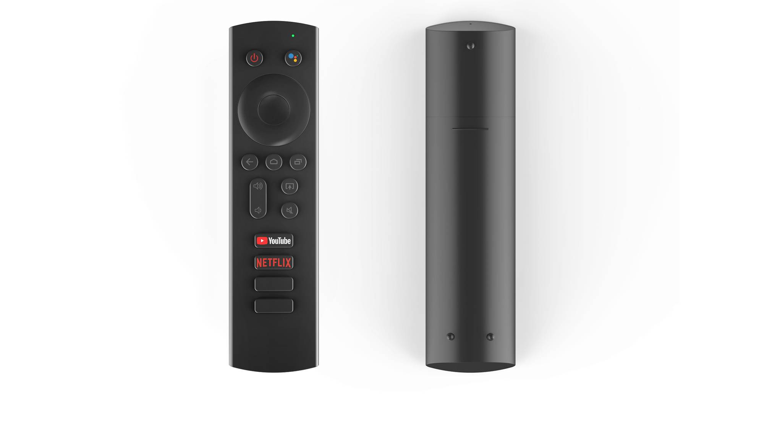
Front view
Front view
back view

Slide 4





C.M.F
Printing:
PANTONE 2173C
PANTONE 179C
01. Top Cover
PANTONE 7549C
Material : PC
Color : PANTONE Black C
Finish : Texture(VDI 27)Injection molding
PANTONE 2257C
PANTONE Cool gray 10C
02. Keypad (P+R)
A : Material : PC
Color : PANTONE Black C
Finish : Texture(VDI 27)Injection molding + Printing
B : Material : Rubber
Finish : Injection molding
02. Bottom cover
Material : PC
Color : PANTONE Black C
Finish : Texture(VDI 27)Injection molding
Dimension : 37.1X 145.7 X 16 mm

Slide 5
Date | Version | Description
2021.4.27 | 1.0 | First release.

Slide 6
THANK YOU

